Slide 1
Background
Frequency is a fundamental physical quantity of electromagnetic wave
Maintenance of THz frequency metrology is required for various THz applications
Advent of practical CW-THz sources (THz-QCL, photomixing with UTC-PD, RTD etc)
Precise frequency measurement of
CW-THz wave is required!
However, techniques of absolute frequency measurement of CW-THz wave are still immature!
Notes:
Frequency is a fundamental physical quantity of electromagnetic wave. Recently, THz radiation has emerged as a new mode for sensing and communication. Along with the recent progress of THz technology and science, maintenance of THz frequency metrology is required for various applications in THz region. Furthermore, the advent of practical continuous-wave THz (CW-THz) sources has increased demand for precise frequency measurement of CW-THz waves. However, techniques of absolute frequency measurement of CW-THz wave are still immature.

Slide 2
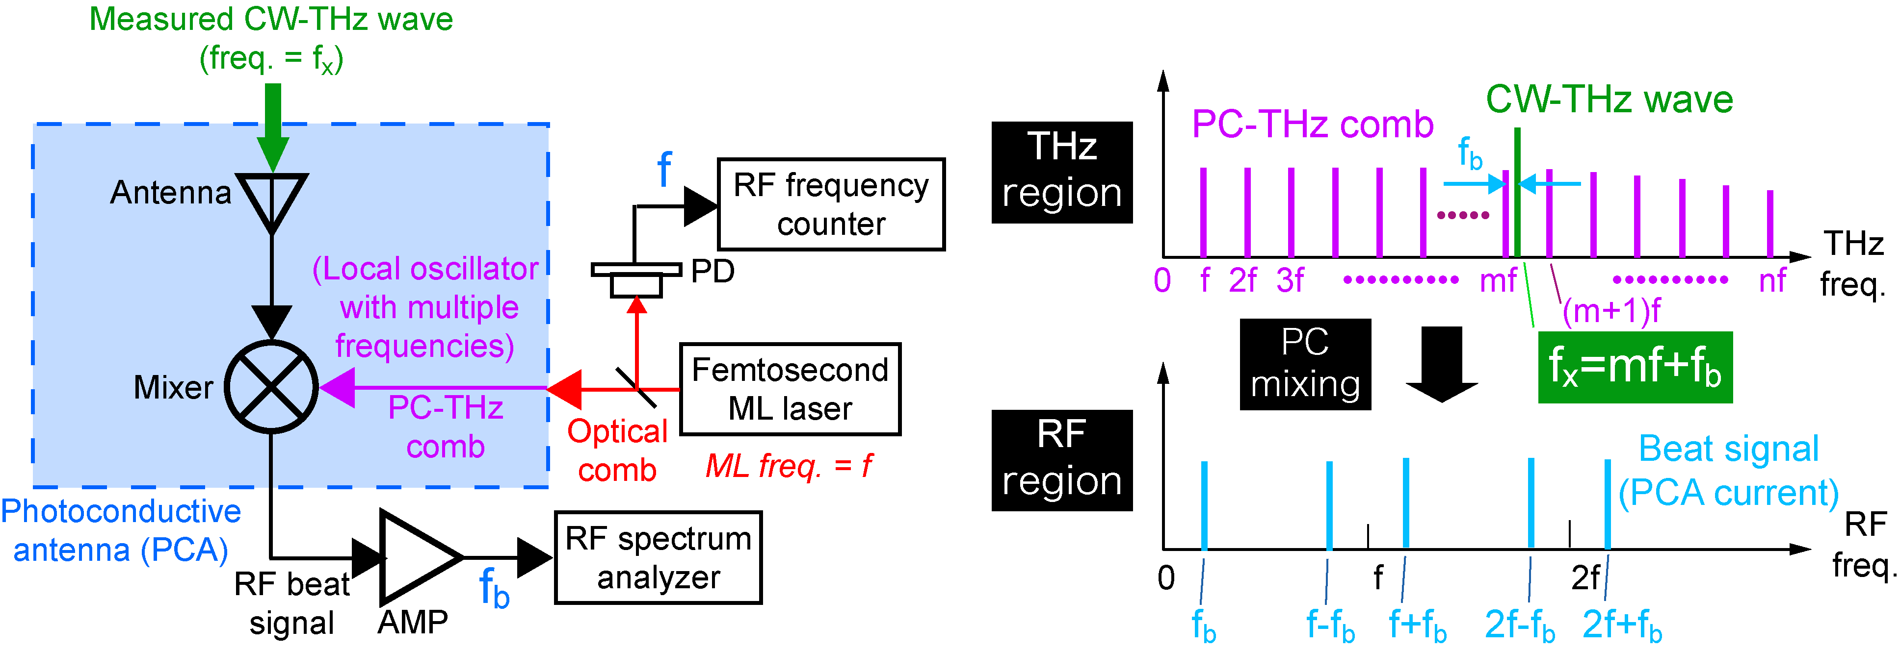
THz spectrum analyzer (1)
Freq. domain
f_{THz}
f_{THz}=mf+f_{b}
f_{THz}=mf ± f_{b}
m: order of comb mode
f: ML frequency
f_{b}: beat frequency
Ref) S. Yokoyama et al, Opt. Express 16, 13052-13061 (2008).
T. Yasui et al. Opt. Express 17, 17034-17043 (2009).
Notes:
The next slide shows the method which is based on heterodyned technique. Compared with the electrical heterodyne technique, a key difference here is that the PCA is used as a heterodyne receiver. This results in high, broadband spectral sensitivity in the THz region without the need for cooling. Another difference is the use of a PC-THz comb whose frequency covers from the sub-THz to the THz region as a local oscillator. The diagram on the right shows spectral behavior of this method. When an optical comb with mode-locked frequency of f is on the antenna gap, the PC-THz comb with mode spacing of f is induced in the PCA like this. And then a measured CW-THz wave is induced on the PCA detector like this. As a result of PC mixing between the PC-THz comb and the CW-THz wave, a group of beat signals between them is generated as a PCA current in the RF region. Here, please focus on a beat signal at the lowest frequency. This fb beat signal is generated by mixing the CW-THz wave at f_{THz} and the m-order mode of the PC-THz comb nearest in frequency to the CW-THz wave at mf. Therefore, the f_{THz} is given by this equation. The f and fb can be easily measured with RF spectrum analyzer or frequency counter. To obtain the f_{THz}, we have to determine the m and sign of the fb.

Slide 3
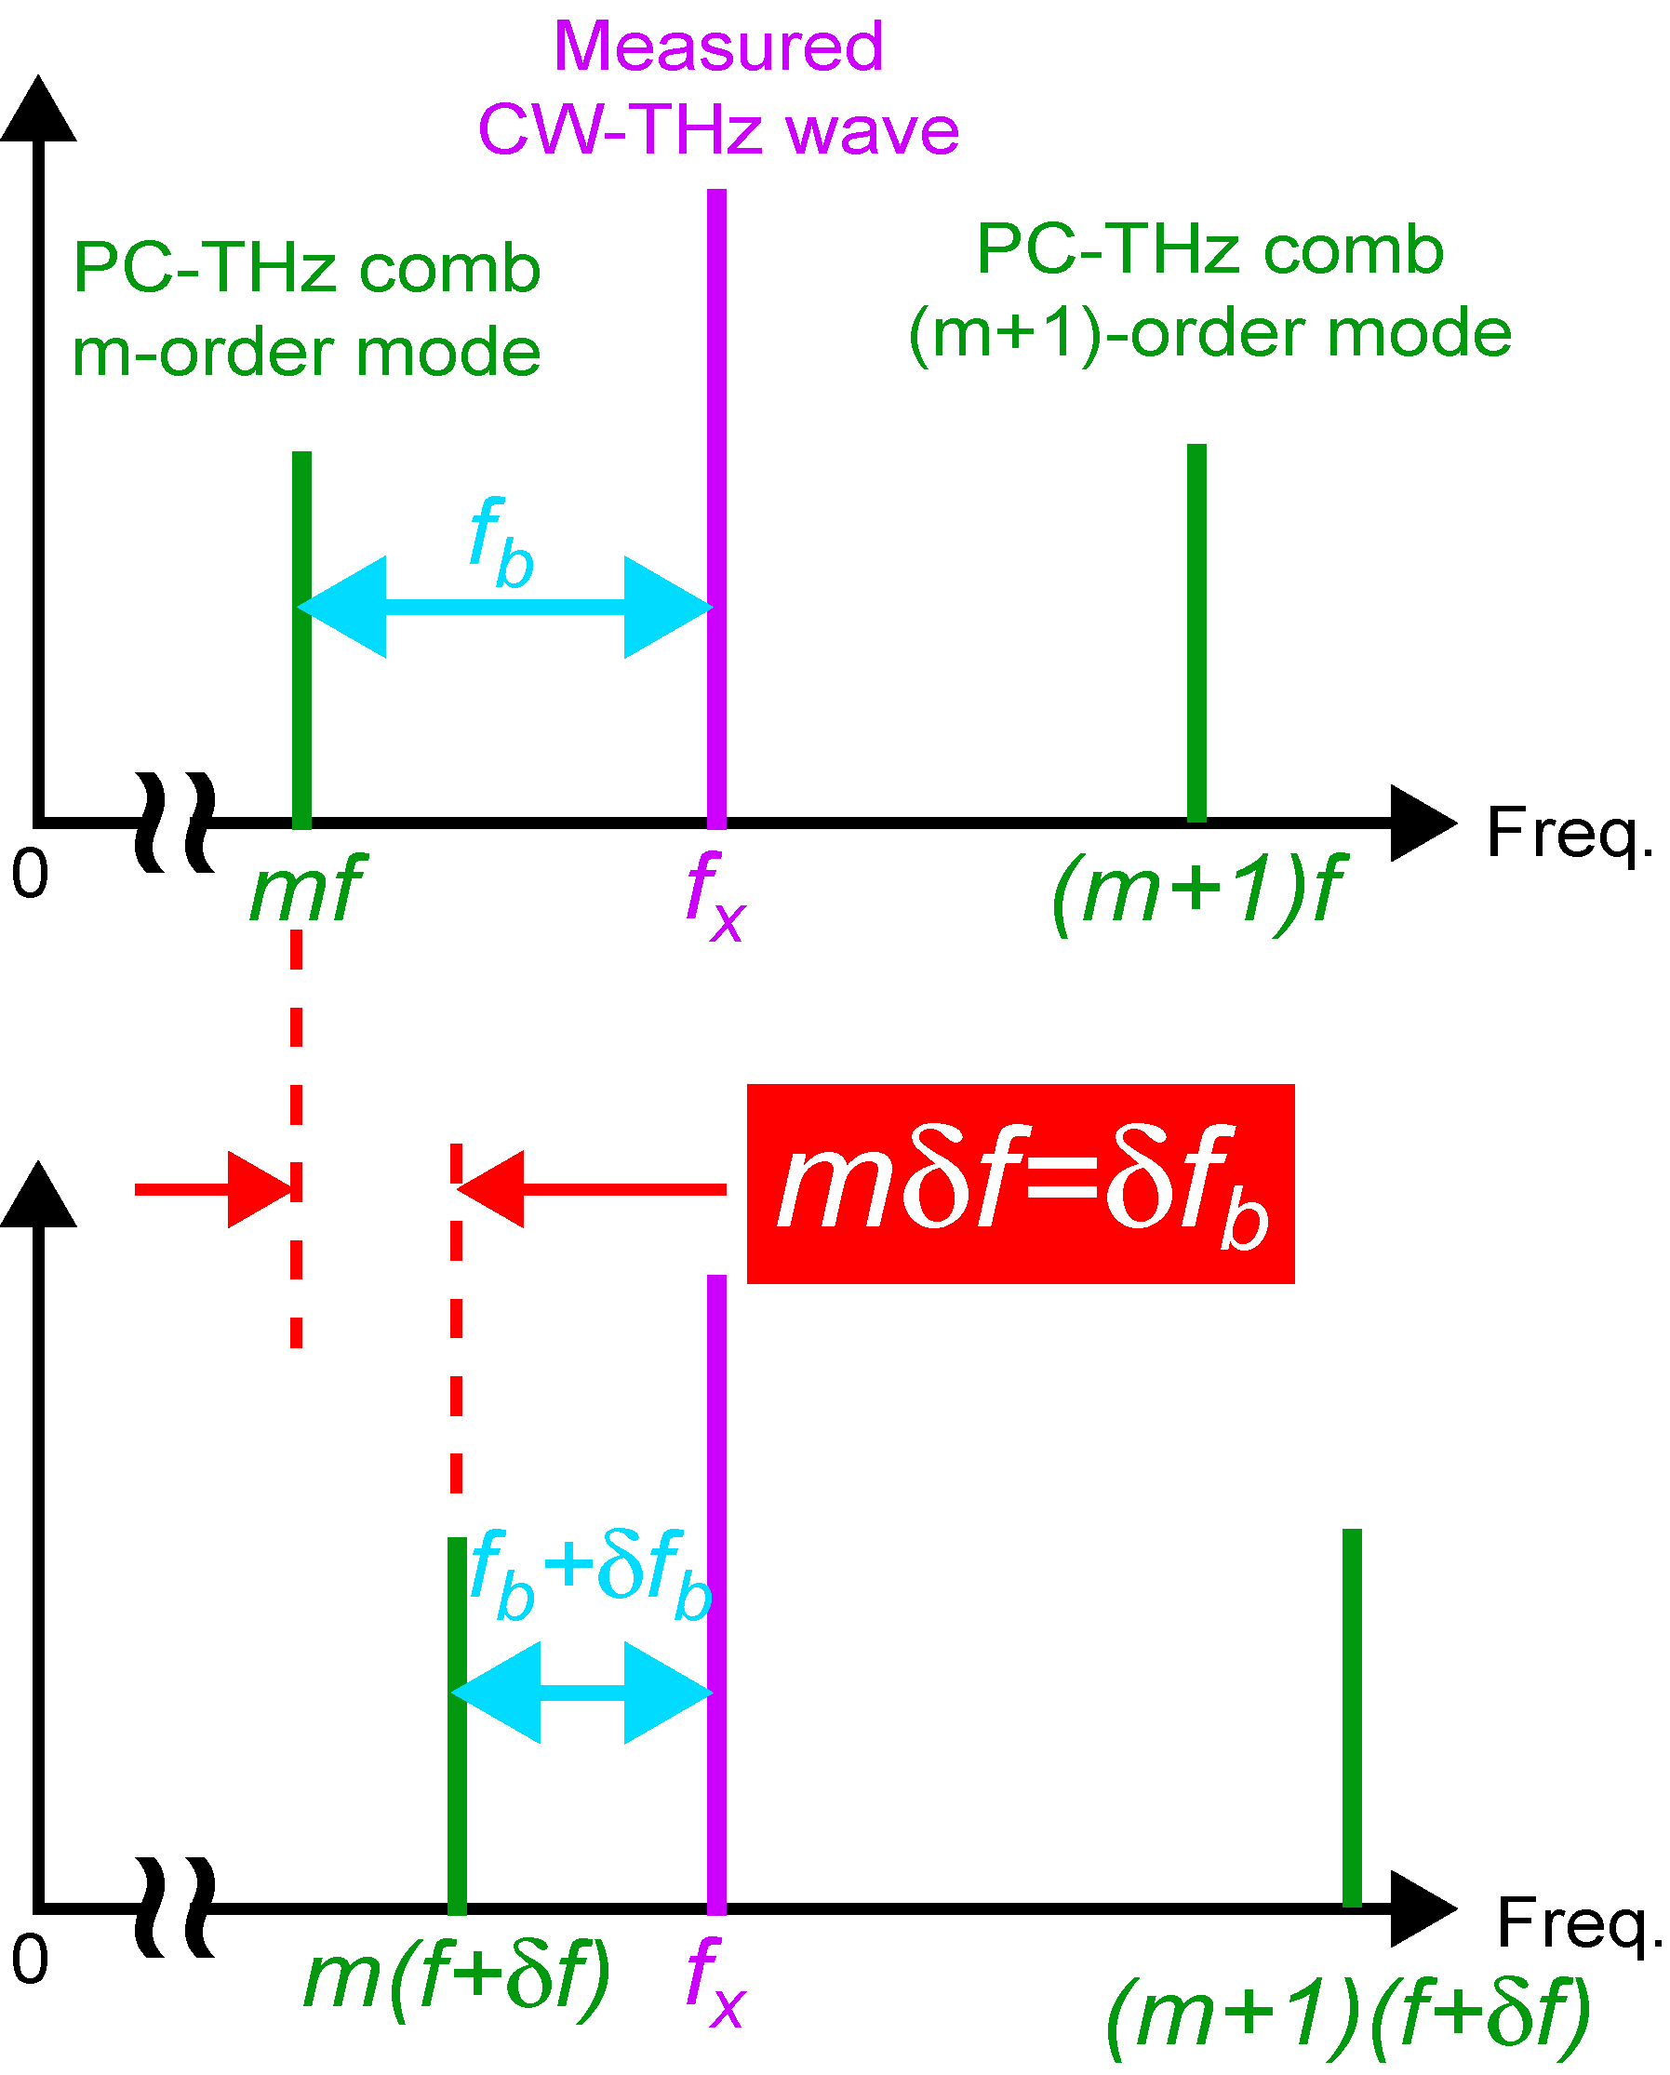
THz spectrum analyzer (2)
Shift of ML freq. by δf (f → f+δf)
Change of beat freq. by δf_{b} (f_{b} → f_{b}+δf_{b})
Notes:
To determine the m and sign of the fb, mode-locked frequency of f is shifted by using the laser control system. This results in the change of the beat frequency δfb. Since δf and δfb must satisfy this relationship, we can determine the m by measuring the δf and δfb. Also, equation of f_{THz} can determine by sign of m. Finally, we can obtain the f_{THz} using this equation.

Slide 4
Previous study
Ref) T. Yasui et al. Opt. Express 17, 17034-17043 (2009).
Absolute frequency
measurement
Real-time monitoring
of CW-THz wave
Active frequency multiplier
F-band UTC-PD
Notes:
Next, I will introduce previous study. The left graph shows the result of absolute measuring of 75~110GHz frequency. The right graph shows a real-time monitoring of the beat signal that uses UTC-PD of F band.

Slide 5
Problems of previous studies for practical use
2-step measurements of beat signal for absolute frequency determination ☞ Not real-time!
Coupling of PCA with 1.5-µm fiber laser light using free-space optics ☞ Not portable!
Present talk
Real-time determination of absolute frequency using dual PC-THz combs
Direct coupling of LT-GaAs-PCA with output fiber tip of 1.5µm fiber laser
Notes:
However, there were two problems in this study. One was that a two-step measurement of beat signal was necessary to determine the absolute frequency. As a result, it was not possible to measure it in real time. Secondarily, the equipment was not portable because the laser beam that entered into PCA used free-space to propagate. Then this time, we aimed at a real-time determination of an absolute frequency that used dual PC-THz combs and at the acquisition of the beat frequency by connecting the fiber laser of 1.5μm directly with PCA.

Slide 6
(1) Real-time determination of absolute frequency using dual PC-THz combs
Notes:
Real time determination of absolute frequency using dual PC-THz combs

Slide 7
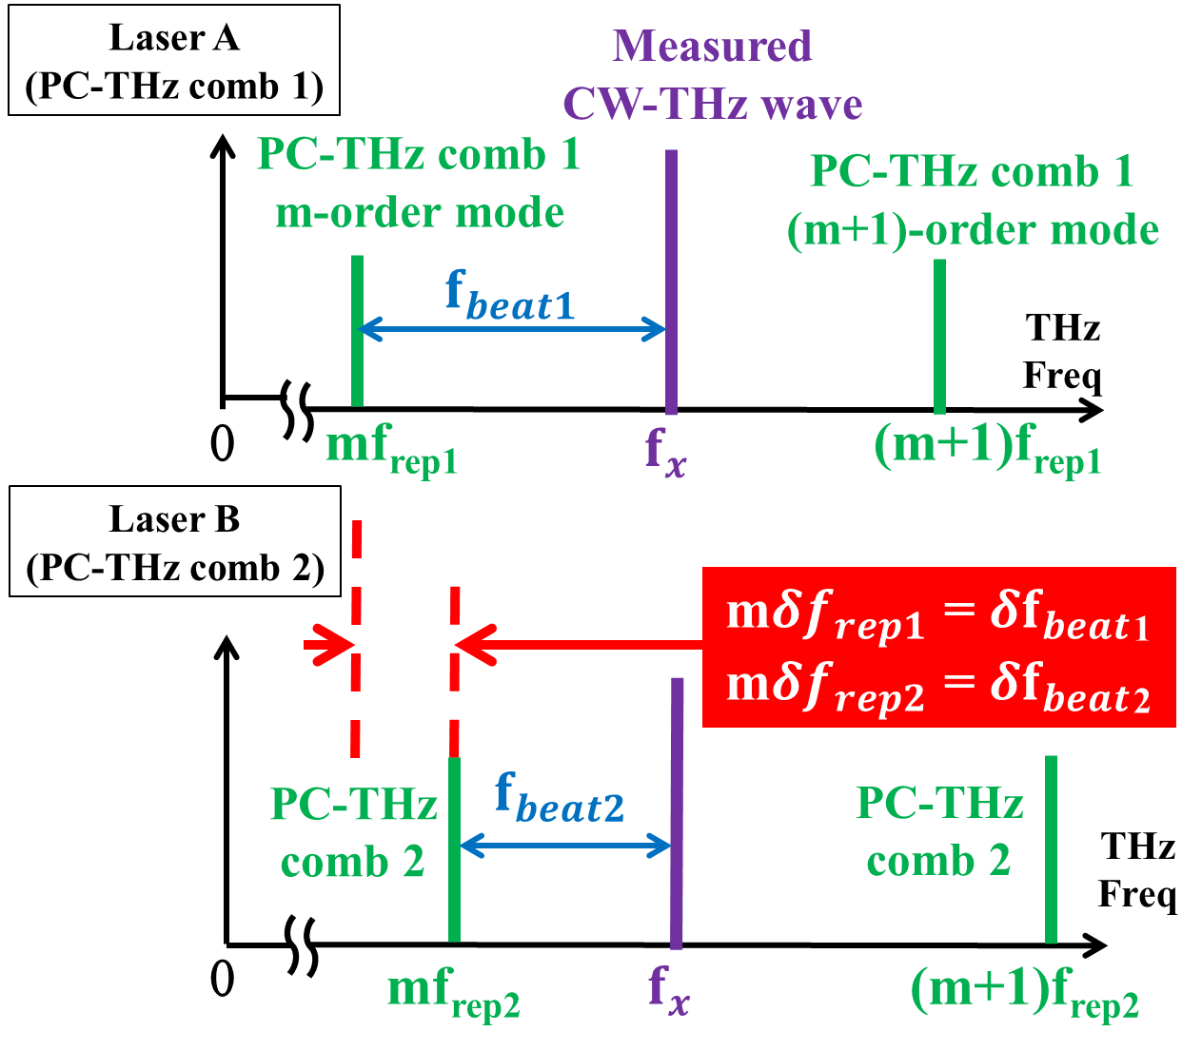
Real-time determination of absolute frequency
Notes:
This slide explains the mechanism to determine the absolute frequency in real time. The point is to use dual PC-THz comb with different mode locked frequency. m can be determined in real time by measuring the beat frequency generated by CW-THz wave and each PC-THz comb at the same time like the equation on the right. Therefore, the frequency can be absolutely determined.

Slide 8
Experimental setup
Notes:
This slide shows the experimental setup of the real-time measurement of the absolute frequency. After the wavelength is converted by the SHG crystal, two laser beams with different mode locked frequency enter PCA. The CW-THz wave whose frequency synthesizer output is multiplied by six is divided into two and enters from the opposite side. Then, the generated beat signal is amplified by the amp and tracking oscillator to a level detectable by the RF frequency counter. We can absolutely measure the frequency in real time by calculating the two beat frequencies measured with the frequency counter with PC.

Slide 9
Beat signals between CW-THz wave and dual PC-THz comb
PC-THz comb (1)
(f_{rep1} = 100,000,000 Hz)
PC-THz comb (2)
(f_{rep2} = 100,000,050 Hz)
f_{beat1}=10,004,000.01Hz
f_{beat2}=9,953,700.002Hz
Real-time determination!
m= |f_{beat1}-f_{beat2}|/|f_{rep1}-f_{rep2}|
=|10,004,000.01-9,953,700.002|/|100,000,000-100,000,050| = 1006
f_{THz} = mf_{rep1}+f_{beat1}) = 1006*100,000,000+10,004,000.01 = 100,610,004,000Hz
Notes:
This slide shows beat signals between CW-THz wave and dual PC-THz comb. The calculation using this beat frequency is like this, and the frequency can be determined.

Slide 10
Accuracy of absolute frequency measurement
Estimation of
measurement error
∆f_{rep1} = 400µHz
∆f_{beat1} = 21mHz
m = 800~1100
↓
∆f_{THz} = 341~461mHz
Mean precision=3.8*10⁻¹⁴
Notes:
To evaluate the precision of the frequency measurement, we set the output frequency of the test source between 80 and 110 GHz and measured the absolute frequency. The blue diagram line shows errors of absolute frequency. And accuracy is indicated by the red diagram line. When the measurement precision is defined as a ratio of errors to the output, the precision of 3.8×10⁻¹⁴ was achieved in this demonstration. Here, I calculated the error of absolute frequency to evaluate this result validity. The result is shown right. As the result, fluctuation of the absolute frequency became 341~461mHz and a value that was about two digits bigger than the outcome of an experiment. It is thought that in the calculation each fluctuation of the frequency is reflected as it is but in an actual measurement fluctuation of the frequency is canceled relatively.

Slide 11
Real-time monitoring of linearly frequency-swept CW-THz wave
Linear sweep
Notes:
Next, this slide shows the result of the absolute frequency measurement by real time when the absolute frequency of CW-THz wave changed linear. From this graph, it understands that can measure sweep of absolute frequency linearly.

Slide 12
(2) Direct coupling of LT-GaAs-PCA with output fiber tip of 1.5µm fiber laser
Notes:
Direct coupling of LT-GaAs-PCA with output fiber tip of 1.5µm fiber laser.

Slide 13
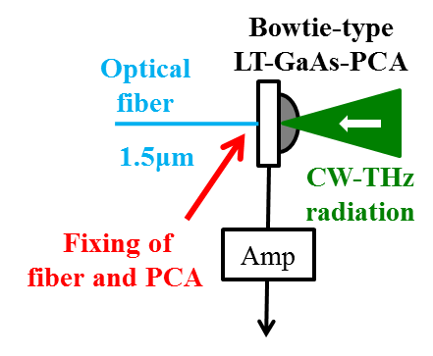
Coupling methods of PCA with1.5-µm light
(1) SHG & lenses @ LT-GaAs PCA
(2) lenses @ LT-InGaAs PCA
Several free-space optics required
Low sensitivity
(3) No optical components @ LT-GaAs PCA
Direct contact
without lens
No free-space, no optics, and moderate sensitivity
Notes:
This slide show the comparison of coupling methods of PCA with1.5µm light. First of all, it is a method of converting wavelength by using the SHG crystal and entering the light into PCA of the gallium arsenic. However, several free space optics required. Moreover, it is a method of entering the light of 1.5μm into indium gallium arsenic PCA. However, there was a problem with low sensitivity. This time, fiber is directly connecting PCA of gallium arsenic. As a result, no free space, no optics, and moderate sensitivity.

Slide 14
Comparison between 0.8-µm and 1.5-μm lights
Beat frequency 100kHz (amp 100kHz, 50MΩ), RBW=3kHz
Dependence of PCA resistance
on incident power
Dependence of beat SNR
on PCA resistance
0.8-µm
light
1.5-µm
light
0.8-µm
light
1.5-µm
light
Notes:
This slide show comparison between 0.8µm and 1.5μm lights. A left graph shows PCA resistance to the laser power. Moreover, a right graph shows Signal-Noise ratio of the beat signal in PCA resistance. As a result, the light of 1.5μm is more inefficient by comparison the light of 0.8μm. However, it was thought that the beat signal was able to be measured also with 1.5μm if the light of strong laser power was used.

Slide 15
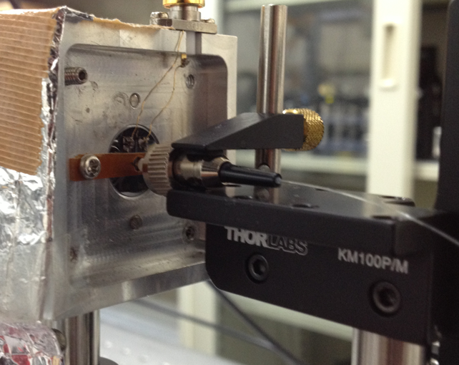
Results
Direct fiber coupling without lens
(P_{mean} = 189mW, f_{rep} = 56MHz)
RF spectrum of f_{b} beat signal
(f_{beat} = 100kHz)
Fiber
25dB
PCA
Direct fiber coupling enables us to construct compact, robust, maintenance-free THz spectrum analyzer for portable use in practical applications!
Notes:
Then, the point of the fiber was fixed to PCA, and it aimed at the acquisition of the beat signal as shown in a left picture. A right graph shows the beat signal of that time. As a result, it is thought that direct fiber coupling enables us to construct compact, robust, maintenance-free THz spectrum analyzer for portable use in practical applications.

Slide 16
Summary
Real-time determination of absolute frequency of CW-THz wave using dual PC-THz combs
Direct coupling of LT-GaAs-PCA with output fiber tip of 1.5µm fiber laser, enabling us to construct a portable system
Future works
Real-time determination of absolute frequency using a single PC-THz comb
Integration of PCA, fiber tip, and amplifier

Slide 17
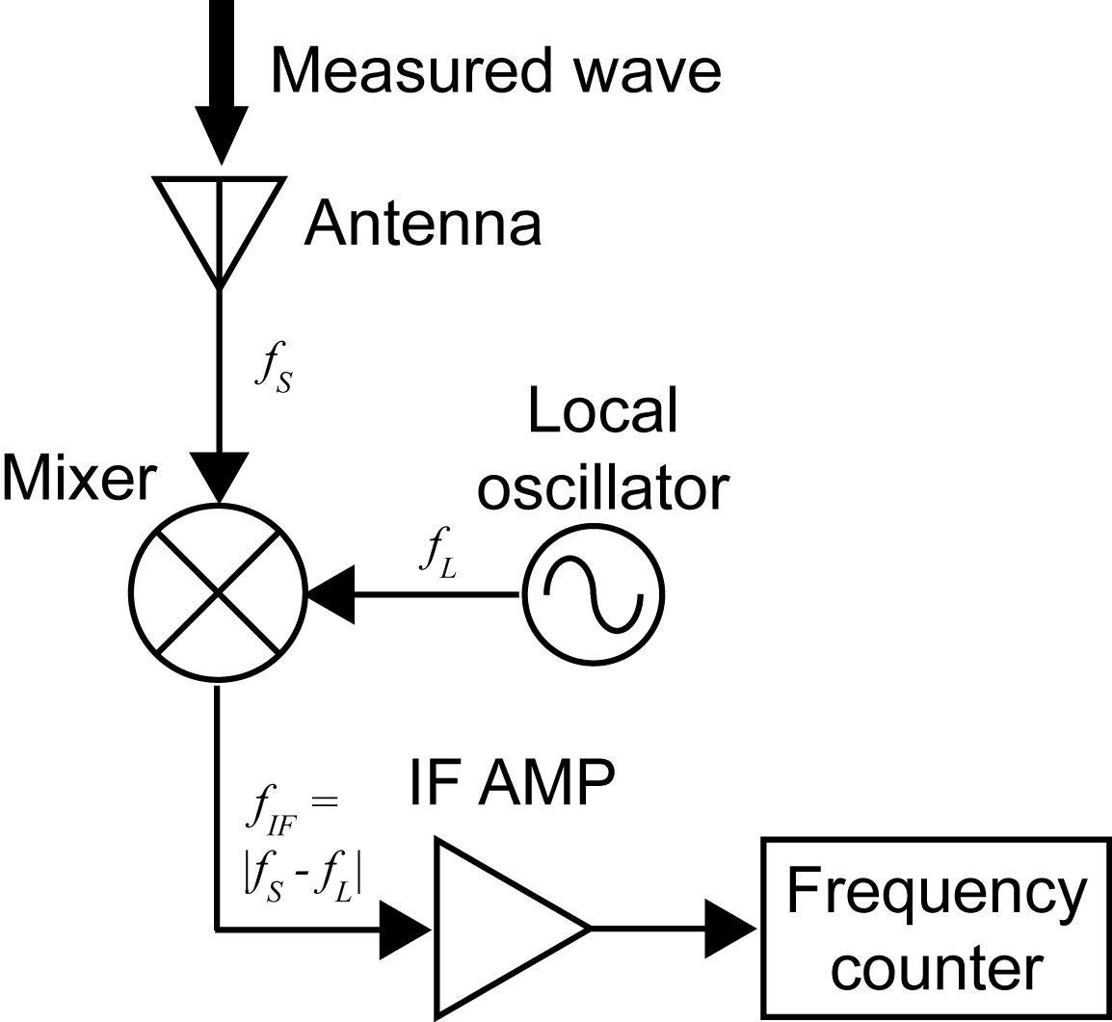
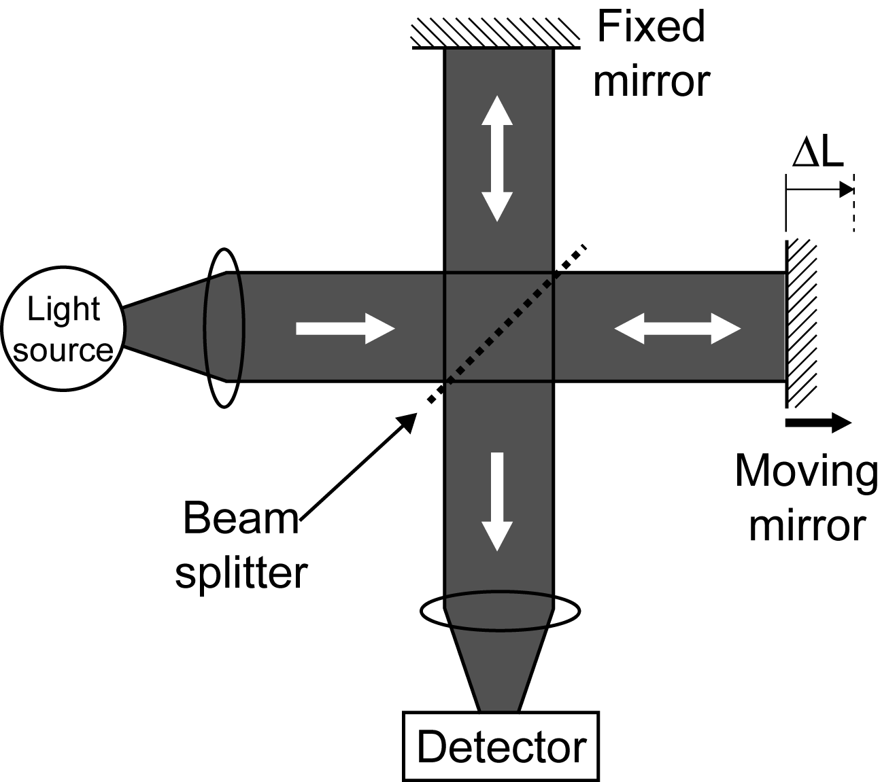
Conventional method
Electrical heterodyned method
Optical interferometric method
Cryogenic cooling
ΔL=(λ/2)*N
Obstacle to
practical use!
Difficult to cover all frequency region of THz wave (0.1~10THz)
→Requirement of new method optimized for THz wave!
Notes:
Conventionally, ele^ctrical he^terodyned method and o^ptical interfero^metric method have been widely used. However, these methods often requires cryoge^nic cooling of mixer or detector to suppress thermal noise. This results in obstacle to practical use. Furthermore, even though such cooling is applied for these methods, it is still difficult to cover all frequency region of THz wave. In this way, THz gap of frequency measurement is existing between electrical and optical regions. Therefore, new method optimized for THz wave is required. To bridge the THz gap of frequency measurement, we focus on the THz frequency comb.

Slide 18
Tracking Oscillator
入力周波数の変動はVCOがトラッキングし, 位相同期を維持
位相同期により入力信号を増幅
SN比の向上
トラッキングオシレーターを用いて絶対周波数の
リアルタイム測定を目指す
Notes:
トラッキングオシレーター (T/O) は, 微弱入力信号の周波数と電圧制御発振器 (VCO) の周波数を比較し, 位相同期を行うという, アナログ的なPLL制御システムである. その結果, 入力周波数が変換しても, VCOが追跡 (トラッキング) し, 常に位相同期を維持する. 通常, VCO出力の信号レベルやSN比は入力信号よりも十分に高いので, 位相同期されたVCO出力信号は, 間接的に, 入力信号を増幅するだけでなく, SN比も向上された信号と見なすことが出来る.
トラッキングオシレーターに入力された信号は位相・周波数検出される. オフセットとゲインによりに, LPF (ループパスフィルター) の条件を変化させ, 入力信号と同じ周波数にされた信号がVCOから出力される. VCOの信号はOutに出力される. また分周器を通った信号の周波数は分周比Nによって1/N倍され, 1/N Outから出力される. この信号は再び位相/周波数検出器にも戻り位相と周波数が一致するように制御されている. ここで分周器とは, ある信号の周波数を整数分の一に分けるものである..

Slide 19
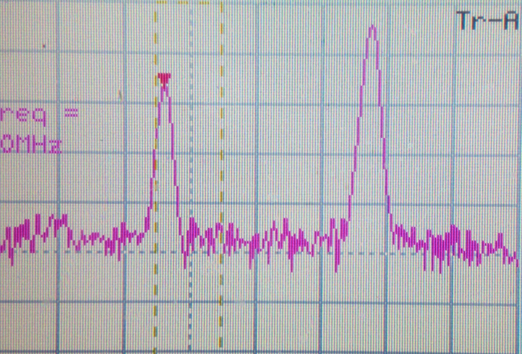
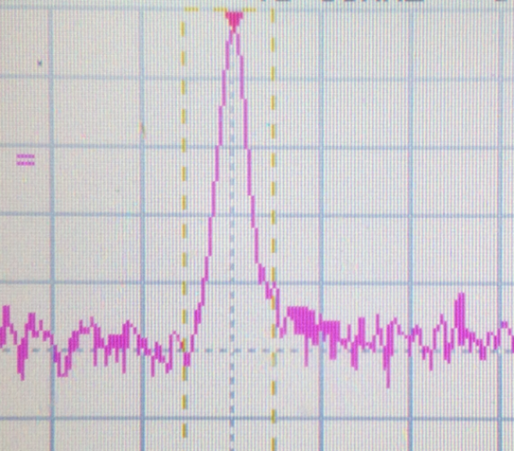
Tracking Oscillator の特性評価
Beat signal
TO signal
Lock signal
SN 45dB
SN 47dB
SN 30dB
最低30dB (RBW10kHz) のビート信号においてトラッキングオシレーターでロック可能

Slide 20
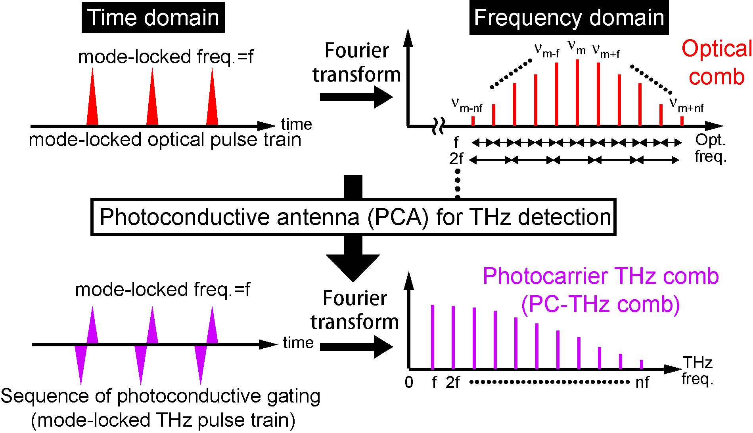
Optical comb and THz comb
Simple, broadband selectivity, high spectral purity,
offset free, and absolute frequency calibration
Notes:
This slide shows behavior of optical comb and THz comb in time and frequency domains. Recently, in the optical region, optical frequency combs radiated from a femtosecond mode-locked laser have attracted attention as a powerful tool for optical frequency metrology because it can be used as a precise frequency ruler in optical region. When the mode-locked optical pulse is incident to the PCA for THz detection, a sequence of photoconductive gating is induced in the PCA. Such photoconductive ML THz pulse train constructs frequency comb structure of photocarrier in the PCA, namely PC-THZ comb. In this way, the optical comb is down-converted to the THz region without any change in its frequency spacing. The resulting PC-THz comb is a harmonic frequency comb without any offset, composed of a fundamental component and a series of harmonic components of a mode-locked frequency of f. Such the PC-THz comb provides attractive features for frequency metrology, namely simple, broadband selectivity, high spectral purity, offset free, and absolute frequency calibration. Therefore, if the laser ML freq. of f is well stabilized, the PC-THz comb can be used as a precise frequency ruler in the THz region. At the present talk, we proposed a THz spectrum analyzer based on the PC-THz comb.

Slide 21
② Experimental setup
Center wavelength 1550nm
Repetition rate 56MHz
Pulse width 47fs
Average power 189mW
Er:fiber laser

